Slide 1
The Travelling Salesman
Michał Jakóbczyk
Marta Miler
GKiO3

Slide 2
Problem
Given a list of cities and the distances between each pair of cities, what is the shortest possible route that visits each city and returns to the origin city?

Slide 3
Problem
The traveling salesman problem consists of a salesman and a set of cities.
The salesman has to visit each one of the cities starting from a certain one (e.g. the hometown) and returning to the same city. The challenge of the problem is that the traveling salesman wants to minimize the total length of the trip.
The salesman can visit the city only once.
NP-hard problem, it gets exponentially more difficult to solve the more dots, or cities, the salesman has to visit.

Slide 4
History
Mathematical problems related to the traveling salesman problem were treated in the 1800s by the Irish mathematician Sir William Rowan Hamilton and by the British mathematician Thomas Penyngton Kirkman.
The general form of the TSP appears to be have been first studied by mathematicians starting in the 1930s by Karl Menger in Vienna and Harvard

Slide 5
Solution
Genethic Algorithm in a specialized way
A valid solution would need to represent a route where every location is included at least once and only once
Swap mutation
Ordered crossover

Slide 6

Swap mutation
Two location in the route are selected at random and then their positions are simply swapped
Because swap mutation is only swapping pre-existing values, it will never create a list which has missing or duplicate values when compared to the original

Slide 7
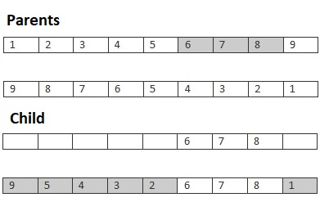
Ordered crossover
In this crossover method we select a subset from the first parent, and then add that subset to the offspring. Any missing values are then adding to the offspring from the second parent in order that they are found.

Slide 8
References
http://www.csd.uoc.gr/~hy583/papers/ch11.pdf
https://en.wikipedia.org/wiki/Travelling_salesman_problem
http://www.theprojectspot.com/tutorial-post/applying-a-genetic-algorithm-to-the-travelling-salesman-problem/5
https://web.archive.org/web/20131217224319/http://www.math.uwaterloo.ca/tsp/index.html
https://blog.routific.com/travelling-salesman-problem-vehicle-routing-problem-e5834f652a76

